Slide 1
DAY 2
TECHNICAL COMMUNICATION

Slide 2
CHARACTERISTICS OF TECHNICAL COMMUNICATION ?

Slide 3
Good technical communication is accurate, clear, concise, coherent, and appropriate.
Addresses particular readers;
Helps readers to solve problems;
Reflects an organization's goals and culture;
Is produced collaboratively;
Uses design to increase readability; and Consists of words or graphics or both.

Slide 4
IMPORTANCE / SIGNIFICANCE

Slide 5
Helps to advance our economy by ensuring viable research and development (includes activities that companies undertake to innovate and introduce new products and services), safeguarding design and manufacturing, and protecting consumers through accurate and informative documents.
Help employers understand and complete job tasks more successfully.
Technical communication is continually shaped by the advancing technologies that facilitate its process, practice, and professionalization.
Improved corporate culture

Slide 6
Essential Skills of Technical Communication

Slide 7
Facility with technology
Ability to write clearly
Talent in showing ideas graphically
Patience in problem-solving/troubleshooting
Ability to interact with Cross-Functional Teams (CFTs)

Slide 8
Indicators of Excellence in Technical Communication

Slide 9
Honesty
Clarity
Accuracy
Comprehensiveness
Accessibility
Brevity (contradicts clarity and comprehensiveness.)
Professionalism

Slide 10

AUDIENCE ANALYSIS
BASIC CLASSIFICATION
Primary Audience
Secondary Audience

Slide 11
PRIMARY AUDIENCE
Consists of people who have a direct role in responding to your documents.
Includes people who use your information in doing jobs.
Evaluate and revise your document, or
Act on your recommendations.
For example, Distance Education Learners depending on the Self Learning Materials (SLM) provided by the University for the preparation of University examinations.

Slide 12
SECONDARY AUDIENCE
consists of people who need to know what is being planned, such as sales people who want to know where a new facility will be located, what products it will produce, and when it will be operational.
Does not have a direct role in responding to your document.

Slide 13
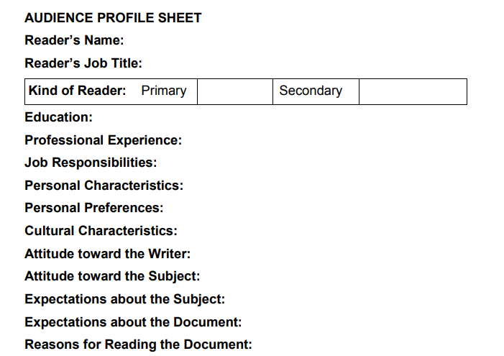
AUDIENCE PROFILE SHEET

